Slide 1
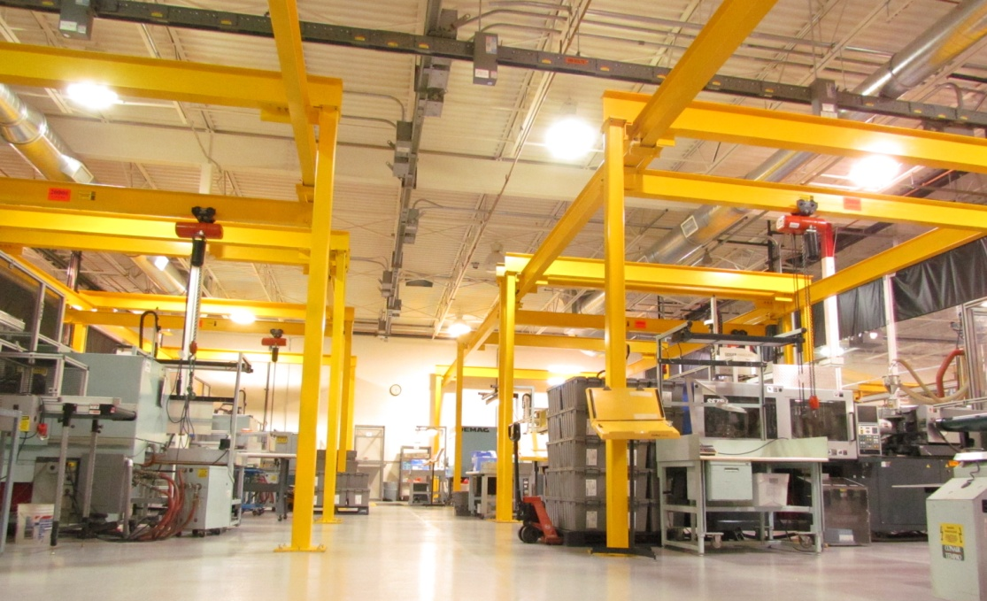
Osceola Medical Operations
Class 8 Clean Room
Controlled White Space
Controlled Molding
Secondary Operations
IQ/OQ/PQ Validations
Device Packaging Solutions
Decoration Solutions
SPC Monitoring & Controls
Certified Minority Supplier
Excellent Customers Service & Delivery
Engineering & Tooling Support
Cost Effective New Product Solutions
High/Low Volume Welcome

Slide 2
Medical Device Assembly Subcuticular Skin Stapler (proprietary absorbable staples)

Slide 3
Medical Device Assemblies
Pleural Air Leak Sealant
Delivery Device
Laparoscopic Electrode
All-in-One Device

Slide 4
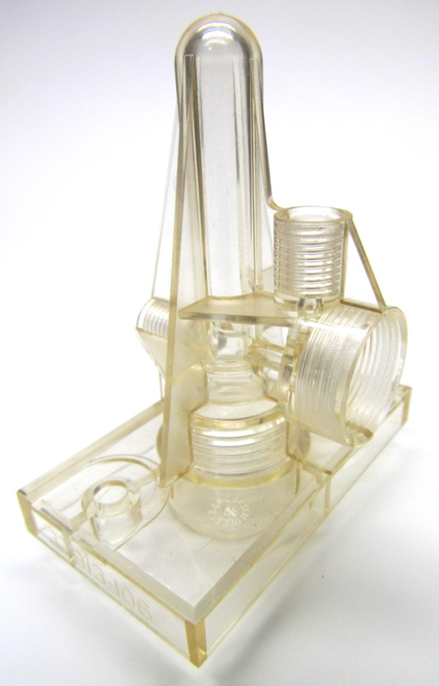
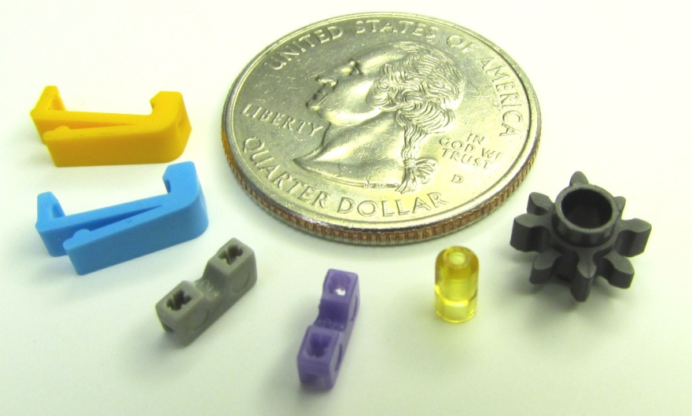
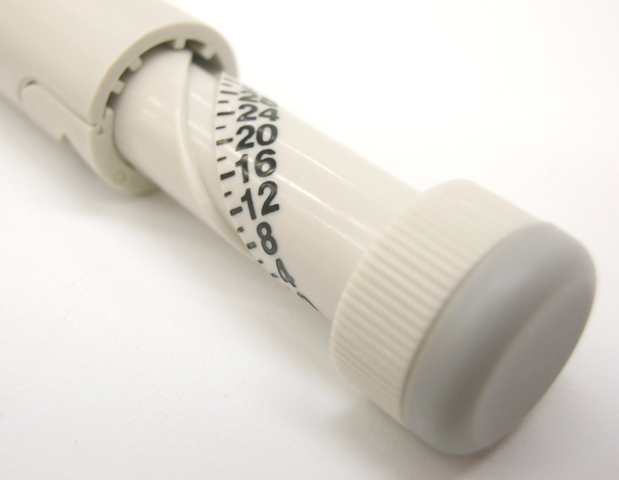
Controlled Molding Products

